Slide 1
MongoDB Scans
Sandhya Rani

Slide 2
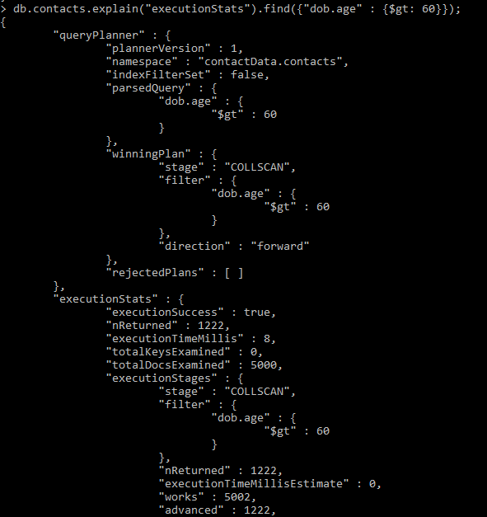
COLLSCAN Before Index creation

Slide 4
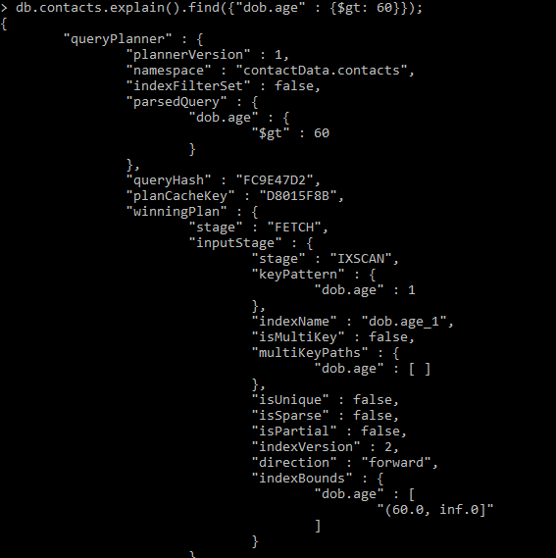
IXSCAN After Index creation

Slide 5
